Slide 1

Hardware
Information Systems and Management

Slide 2
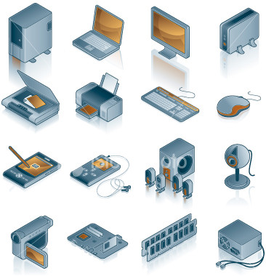
Hardware
Any machinery (with digital circuits) that assists the input, processing, storage, and output activities of an information system.

Slide 3
  Outdated hardware may result in a competitive disadvantage
  Hardware must support the software applications which in turn facilitates business operations

Slide 4
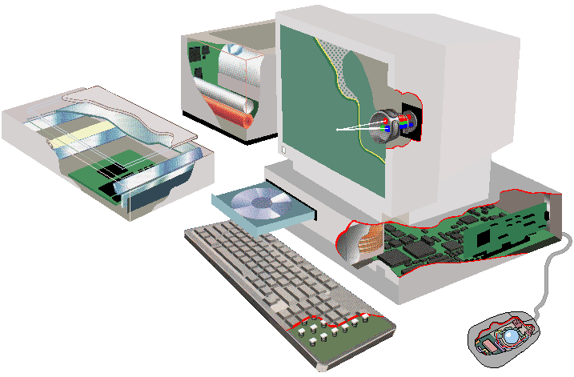
Hardware Components
CPU
  A/L Unit
  Control Unit
  Registers
Primary Storage
  Holds program instructions and data

Slide 5
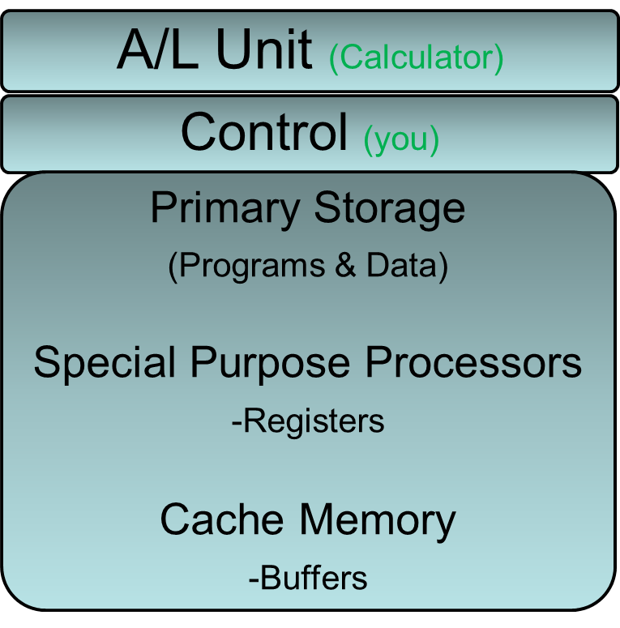
The Central Processing Unit
Input
(In-Basket)
Output
(Out-Basket)
Secondary Storage
(File Cabinet)
Desk
Phone: I/O Device Radio: I Device only
Garbage: O Device (1 day storage)

Slide 6
Hardware Components in Action
Execution of any machine – Level instruction
Instruction Phase
  Step 1: Fetch instructions
  Step 2: Decode and pass to appropriate unit
  Instruction time:
  Time it takes to perform this phase

Slide 7
Execution Phase
  Step 3: Carry out the instruction
  Step 4: Store result in register or memory
  Execution time:
  Time it takes to perform this phase

Slide 8
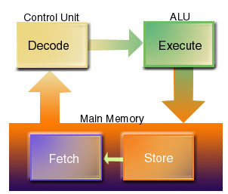
Machine Cycle
  Steps 1 – 4
Pipelining
  Each step is active at the same time
  Pentium 4 can execute 2 instructions per machine cycle

Slide 9
Processing Characteristics and Functions
        Machine Cycle Time
        Clock Speed
        Micro Code
        BIT
        Word Length
        Bus Line

Slide 10
Machine Cycle Time
Time to execute a machine cycle
  Micro second (one millionth)
  Pico second (one trillionth)
Instructions per second
  MIPS (millions of instructions per second)

Slide 11
Clock Speed
Electronic pulses produced at a predetermined rate that affects machine cycle time
  Hertz: one cycle per second
  Mega Hertz: millions of cycles per second
  Giga Hertz: billions of cycles per second

Slide 12
Micro code
Predefined, elementary circuits and logical operations that the processor performs when it executes an instruction

Slide 13
BIT
BIT: Binary Digit (1 or 0)
Word length: number of bits the CPU can process at any one time
  The larger the word length the more primary memory locations can be directly addressed
    Requires more sophisticated system software

Slide 14
Bus Line
Queue at a bus stop
Physical system component connections

Slide 15
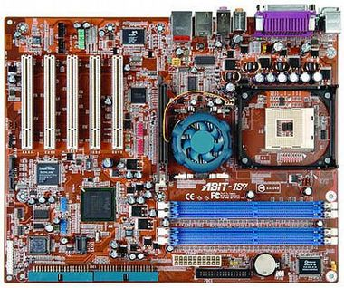
Physical Characteristics of the CPU
Collections of digital circuits imprinted on silicon wafers
An electrical current must flow from points A to B to turn digital circuit “on” or “off”
To increase speed
    Decrease distance
    Reduce Resistance

Slide 16

Moore’s Law
Densities on a single chip will double every 18 months.
Reduce resistance
  Super conductivity: metals that facilitate current flow (gallium arsenide)
  Optical processors: light waves

Slide 17
Complex Instruction Set Computing
CISC: a computer chip design that places as many microcode instructions into the CPU as possible
Reduced Instruction Set Computing
RISC: a computer chip based on reducing the number of microcode instructions built into a chip to an essential set of common microcode instructions

Slide 18
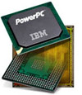
Most operations of a CPU involve only 20% of the available microcode instructions
RISC Chips
    Less expensive to produce
    More reliable
    Faster processing
      Fewer microcode steps
      Use Pipelining

Slide 19
Memory Characteristics
Main Memory
  Provides CPU with working storage for program instructions and data
Storage Capacity
  Byte: 8 bits that together represent a single character of data

Slide 20
Types of Memory
Random Access Memory (RAM)
  Instructions or data can be temporarily stored
  Volatile: lost when power is turned off
Read Only Memory (ROM)
  Permanent storage of data and instructions for start-up activities
  Non-volatile: retained with no power
Cache Memory
  High speed memory that a CPU can access more rapidly than main memory
  Example: recently accessed web pages

Slide 21
Multi programming :
The simultaneous execution of two or more programs at the same time – NOT!

Slide 22
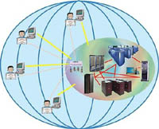
Co-Processor
    Executes instructions while the CPU works on another activity
Massively Parallel Processing
    Linking processors to work at the same time
    Simulations
Symmetrical Multiprocessing
    Share CPU resources
Grid Computing
    Collection of computers
      SETI
    Central Server

Slide 23
Secondary Storage:
Devices that store large amounts of data, instructions and information more permanently than allowed with main memory.

Slide 24
Access Methods
Sequential
  Data are accessed in the order in which it is stored
Direct
  Data can be retrieved without the need to read and discard other data
Index
  Create a separate file with record key and physical address
    Index non-sequential (telephone book)
    Index sequential (postal code)

Slide 25
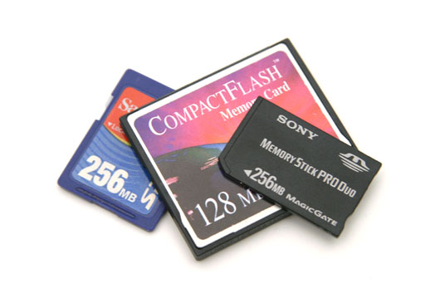
Secondary Storage Devices
Magnetic tape
Magnetic Disc
RAID
Disc Mirroring
Virtual Tape
Optical Disc
DVD
Magneto-optical (MO) Disk
Memory Card
Flash Memory
Expandable Storage

Slide 26
Enterprise Storage Options
Network Attached Storage (NAS)
  Store data on the network not the computer

Slide 27
Input & Output Devices
Data Entry
  Process by which human readable data are converted into machine readable form
Data Input
  Process that involves transferring machine-readable data into the system
Source Data Automation
  Capturing and editing data where the data are intially created and in a form that can be directly input into a computer, thus, ensuring accuracy and timeliness

Slide 28
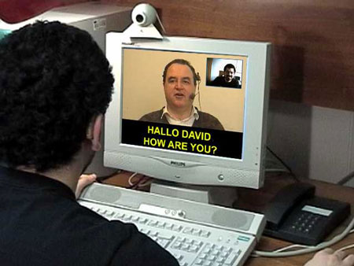
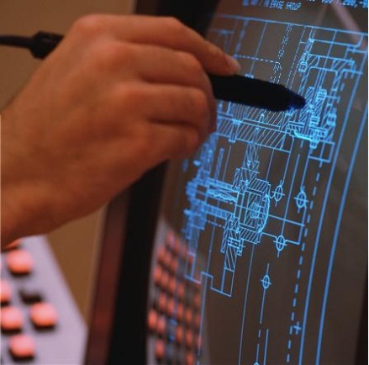
Input Devices
Personal Computer Input Devices
Voice Recognition
Digital Cameras
Terminals
Scanning Devices
Point of Sale (POS)
Automated Teller Machines (ATM)
Pen Input
Light Pen
Touch Sensitive
Radio Frequency Identification (RFID)

Slide 29

Output Devices
Display Monitors
    TV-screen-like device
    Pixel: a dot of colour on a photo image or a point of light
    on a display screen.
    CRT : Cathode Ray Tube
    LCD: Liquid Crystal Display
    LED: Light-emitting Diode
Printers & Plotters
Computer Output Microfilm (COM)
Music Devices

Slide 30

Input/Output
Voice
Optical
  OMR
  OCR
  Bar Codes and UPC
Magnetic Ink (MICR)
RFID
Source Data Automation

Slide 31
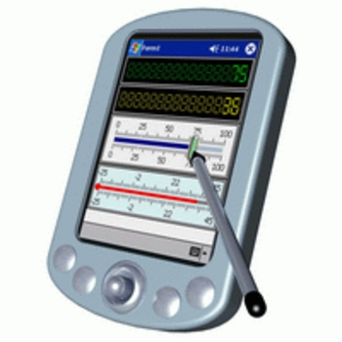
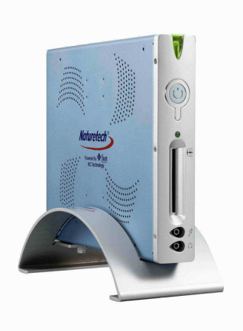
Computer System Types
Handheld
Portable
Thin Client
Desktop
Workstation
Server
Mainframe
Supercomputers

Slide 32
Scalability:
The ability to increase the capability of the computer to process more transactions in a given period by adding more, or more powerful processors.

Slide 33
Selecting & Upgrading Computer Systems
Computer system architecture
Hard Drive
Main Memory
Printers
DVD Burner
Support Fundamental Objectives
Current and Future Business Needs

Slide 34
Major Trends in Computer System Capabilities
 | First Generation | Second Generation | Third Generation | Fourth Generation | Fifth generation?
Size (Typical computers) | Room Size Mainframe | Closet Size Mainframe | Desk-size Minicomputer | Desktop & Laptop | Networked Computers
Circuitry | Vacuum Tubes | Transistors | Integrated Semi-conductor Circuits | Large-Scale Integrated (LSI) Semiconductor Circuits | Very-Large-Scale Integrated (VLSI) Semiconductor Circuits

Slide 35
General Trend
Smaller
Faster
More Power
More Reliable
Cheaper
  For the functionality

Slide 36
Terms
Multiprocessors
  More than one CPU
Multi programming
  More than one program “resident” in CPU
  Only one can run
Multitasking
  Multiprogramming on a micro

Slide 37
Hardware
Information Systems and Management

